Slide 1

Project plan
TRUSS 1 group

Slide 2
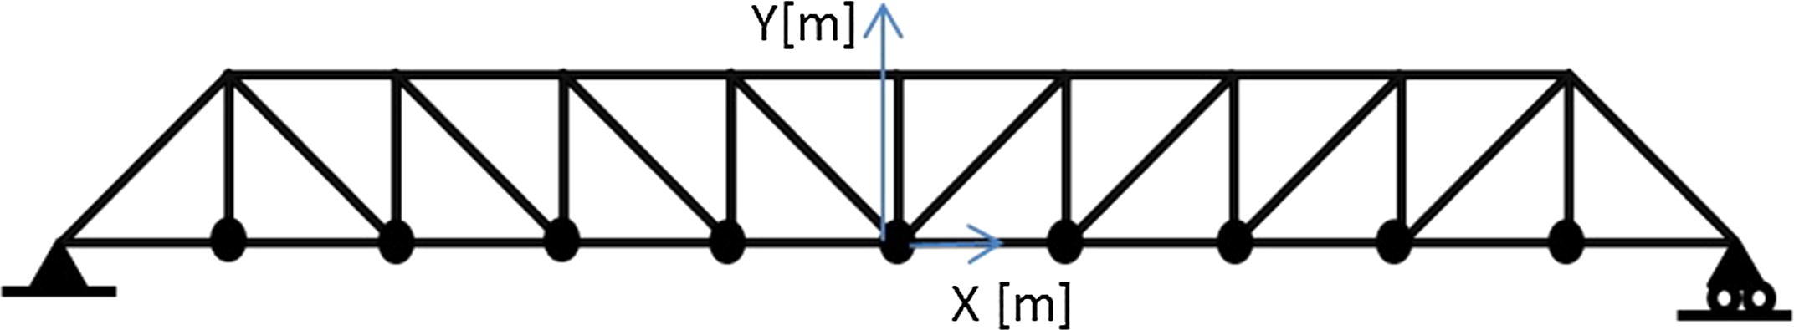
Problem definition
Truss construction
Variables
Symmetric
Black box function -> PyJive
Natural frequencies
Minimize mass inside the constraints

Slide 3
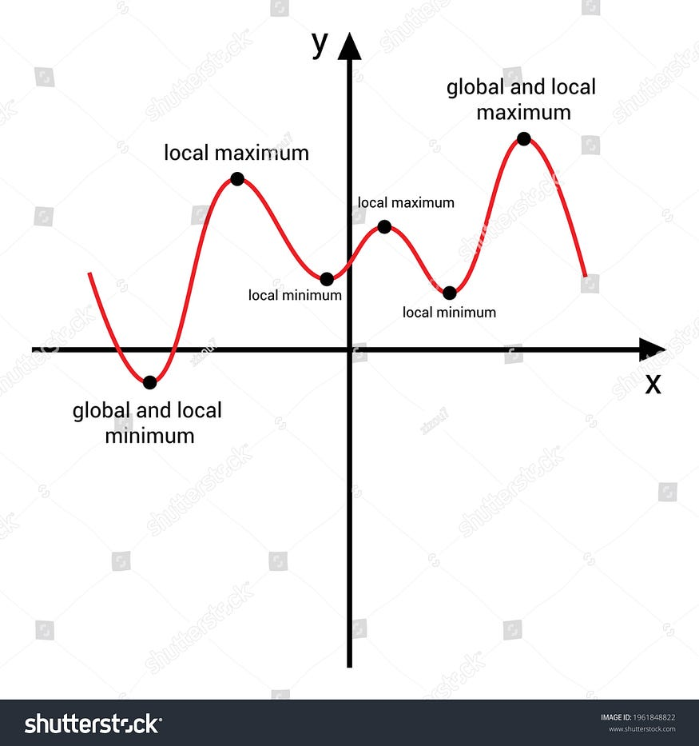

Bayesian optimization exploration vs exploitation

Slide 4
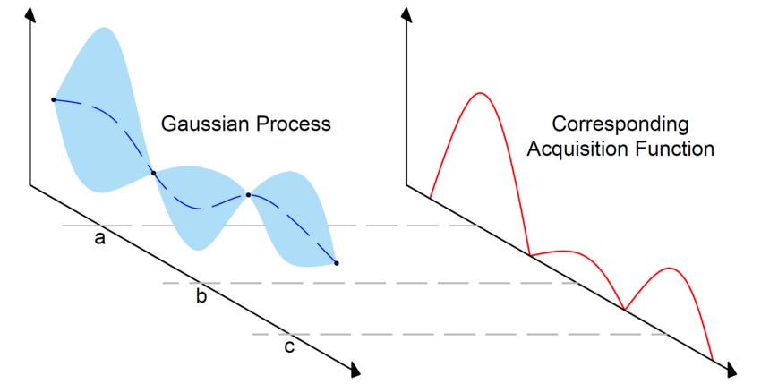
Bayesian optimization

Slide 5
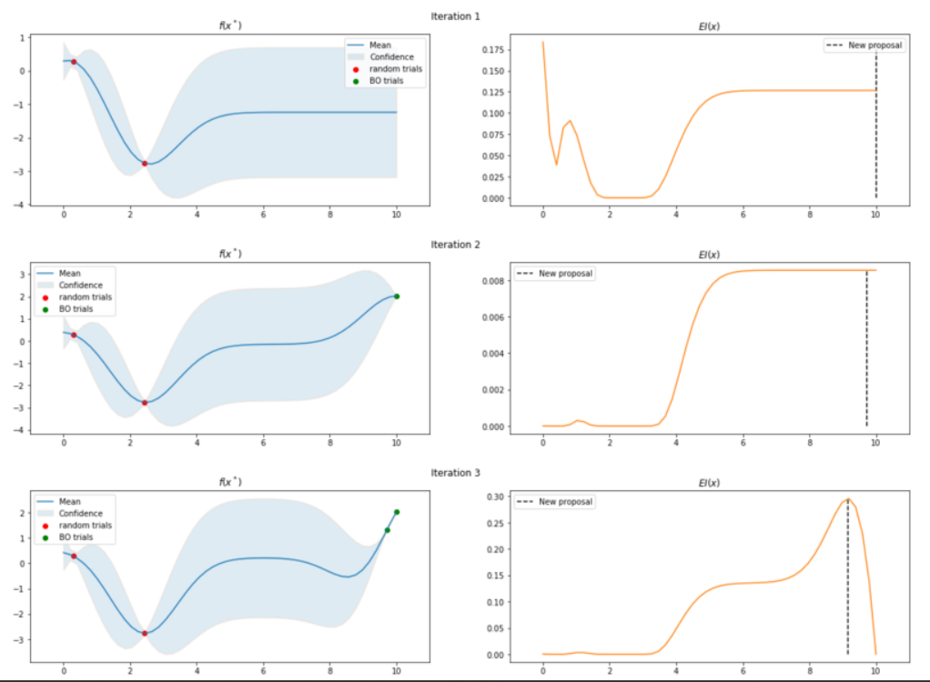
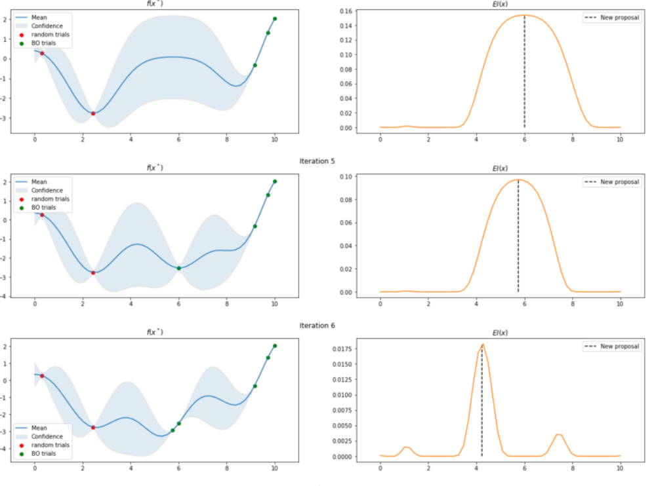
Bayesian optimization

Slide 6
Steps to take - structure
Use bayesian optimizing class from articles
Define loss function
Constraints
Mass

Slide 7
Steps to take - structure
Adapt acquisition function
Y and Area variables have different scales
Create and store samples
Geometry files
Save in- and outputs

Slide 8
Steps to take - parameters
Define upper and lower bounds for y and A
Tweak parameters
Batch size
Scale
Number of iterations

Slide 9
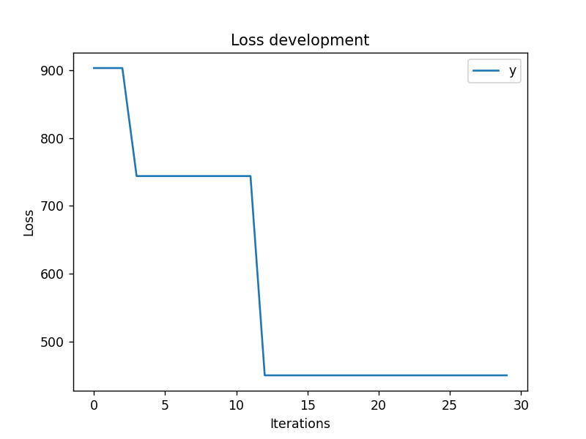
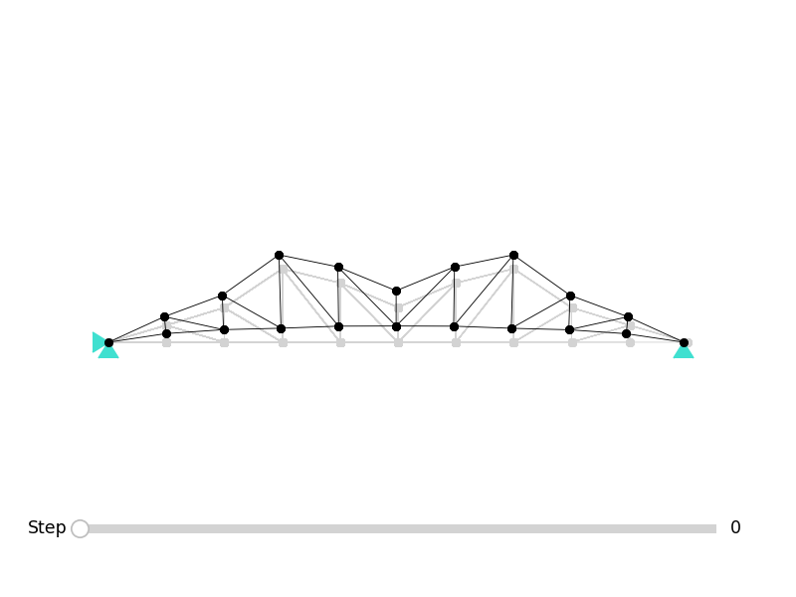
Results so far

